Slide 1

Project By :-
Team Leader :- P. Nitish Kumar
Team Members :- P. Tarun Kumar
P. DurgaRao
G. SaiMukesh
S. Jnanavamsi

Slide 2

Comprehensive Project Work

Slide 3


Slide 4


Part 1: Brand study, Competitor Analysis & Buyer’s/Audience’s Persona
Company/Topic for Project : Tata Motors
Research Brand Identity: Study the brand's mission, values, vision, and unique selling propositions (USPs).
Brand colour :
Blue, White
Logo :
Mission/Values: We innovate mobility solutions with passion to enhance the quality of life. We innovate mobility solutions with passion to enhance the quality of life.
- Integrity
- Teamwork
- Accountability
- Customer focus
USP : Tata Group is one of top Indian Companies and the USP of Tata Motors is that they are fuel efficient and easy to drive. An environmentally conscious customer might buy a Tata vehicle because oil is a nonrenewable resource and an economical person might buy it because of fluctuating prices of oil.
Tagline : Connecting aspirations.

Slide 5

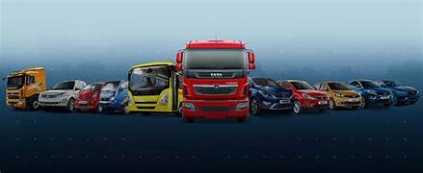
Part 1: Brand study, Competitor Analysis & Buyer’s/Audience’s Persona
Analyze Brand Messaging: Leadership with Trust
Examine the brand's tagline: Connecting Aspirations
It is a symbolic tagline that is representative of the past,present and future

Slide 6

COMPETITOR ANALYSIS
Competitor 1 MARUTHI SUZUKI
Known for the making vehicles that are priced to suit the needs of every Indian Maruthi suzuki cars go beyond just being affordable.
https://www.marutisuzuki.com/

Slide 7
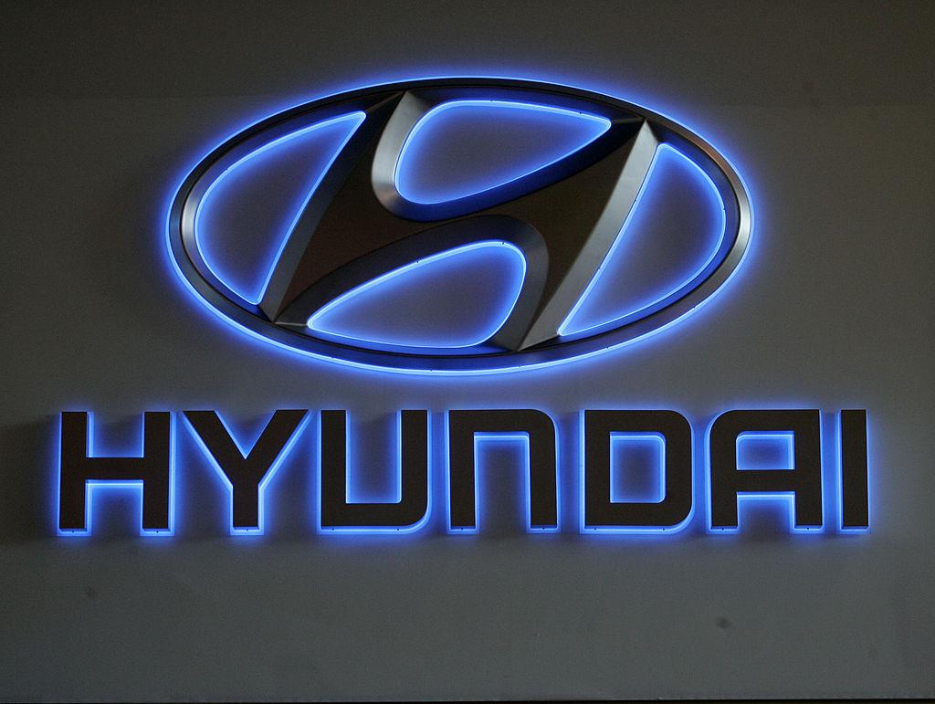
Competitor 2:
HYUNDAI
The strengths of Hyundai looks at the key internal factors of its business which gives
it competitive advantage in the market and strengthens its position.
https://www.hyundai.com/

Slide 8
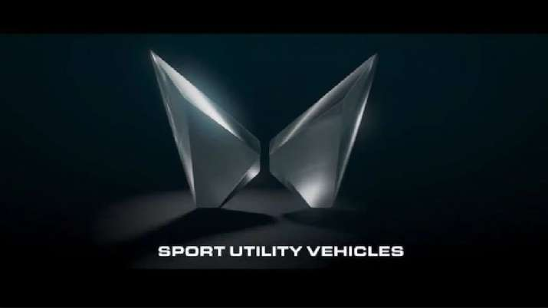
Competitor 3: MAHINDRA
Unique selling proposition lies in it being the largest car manufacture in india in
terms of production and a market leader for multi utility vehiles.
https://www.mahindra.com/

Slide 9
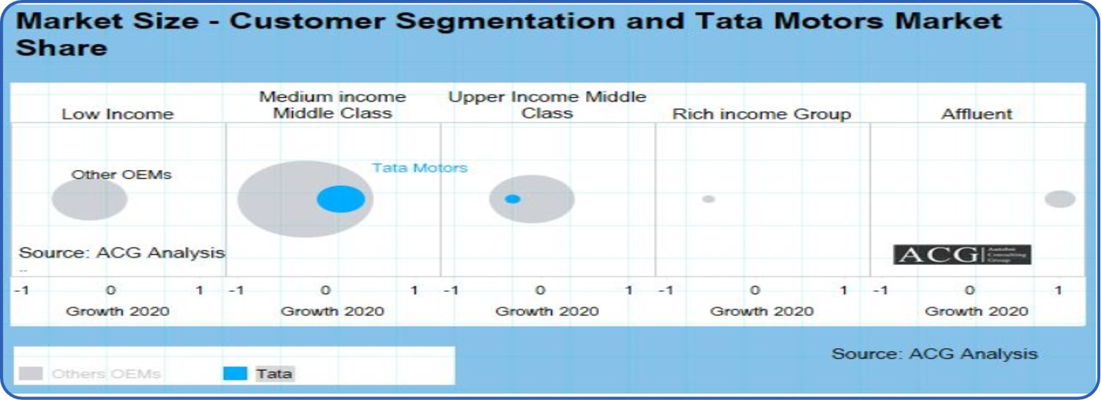
Part 1: Brand study, Competitor Analysis & Buyer’s/Audience’s Persona
Buyer’s/ Audience’s persona:

Slide 10
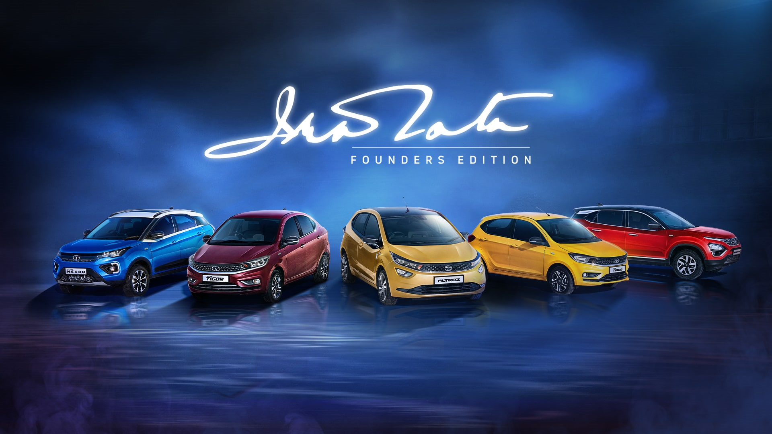
Part 1: Brand study, Competitor Analysis & Buyer’s/Audience’s Persona
Buyer's/Audience's Persona:
TATA MOTORS :
Above 25 yrs
Men and Women
Metro cities like Delhi and Hyderabad
Not Remote Villages
Above 4,00,000 per annum
Ads by the website like GoMechanic,
Youtube, Social Media Platforms
Tata stands for Vocal for Local

Slide 11
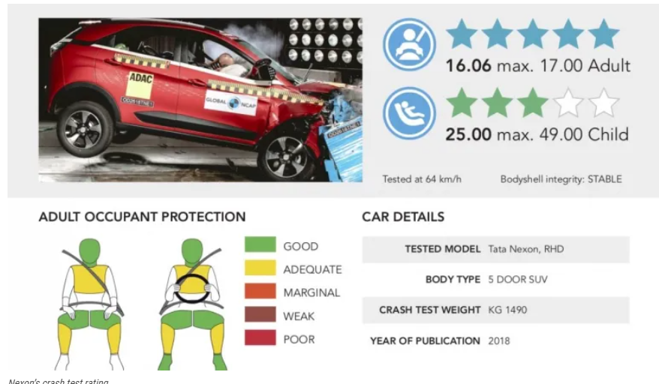
Tata cars are safe
Tata cars are competitively
priced
Tata Cars are Muscular
Tata is a build upon a legacy
Safety is first priority of Tata

Slide 12
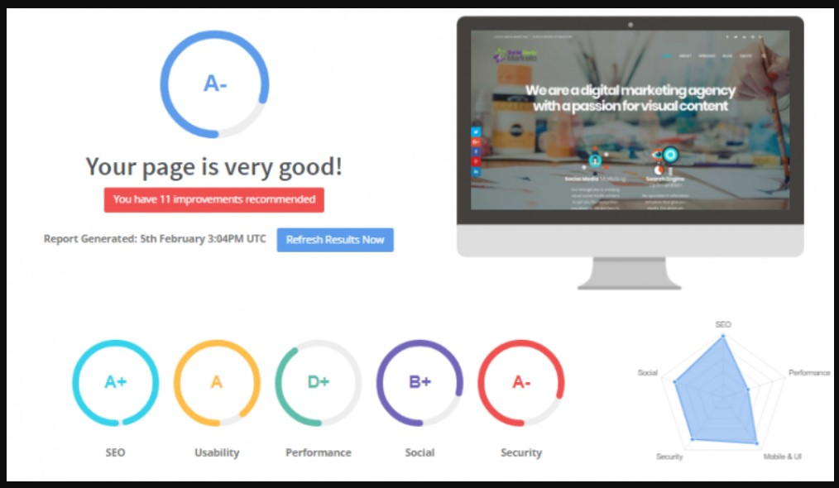
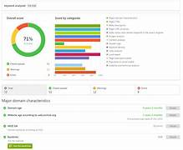
Part 2: SEO & Keyword Research
SEO Audit: Audit result for www.tatamotors.com

Slide 13
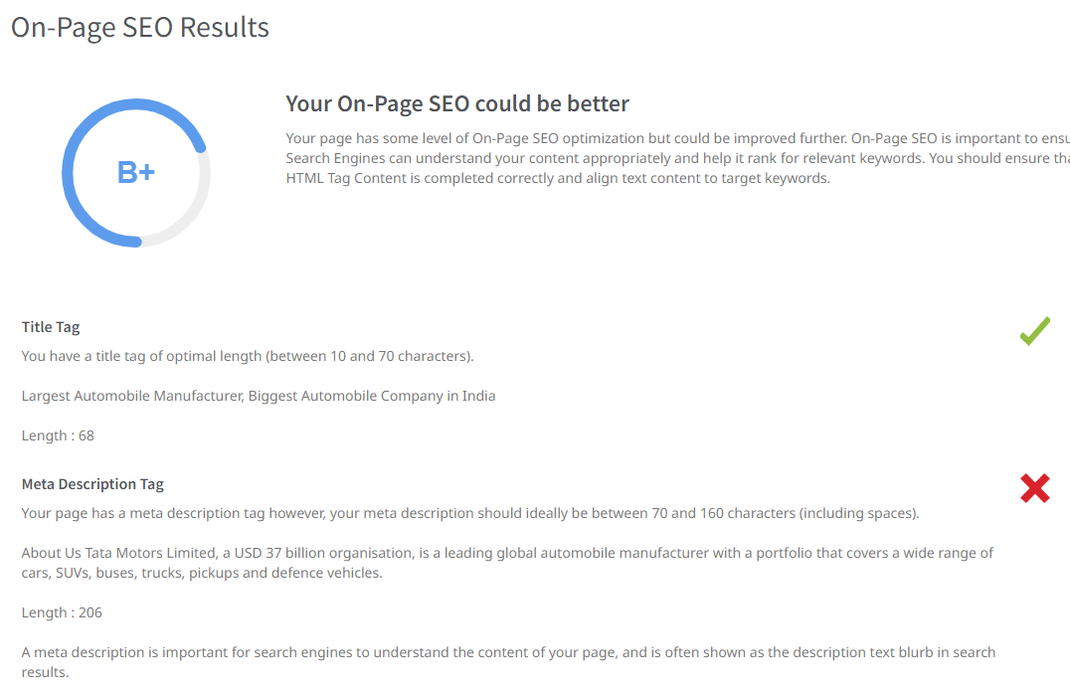

Slide 14
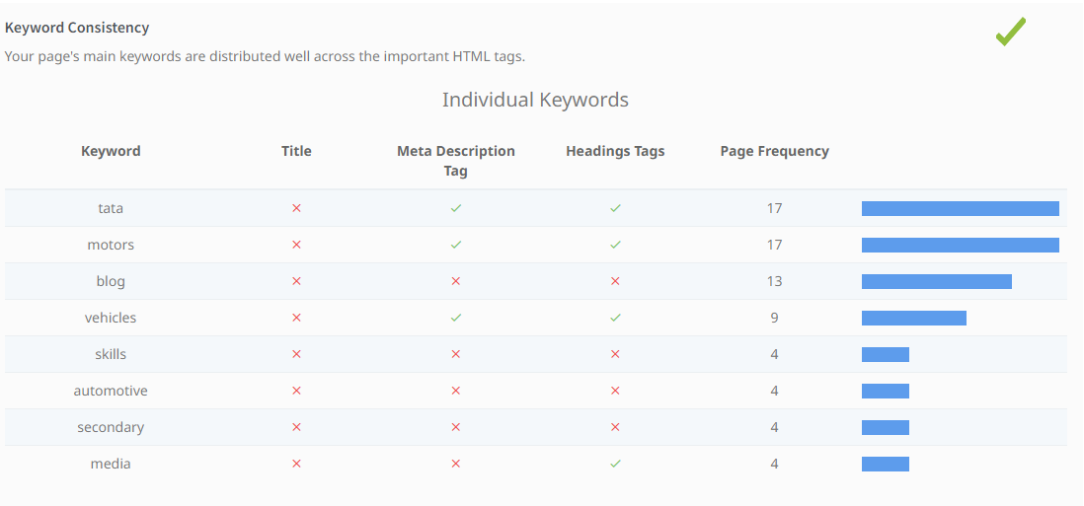
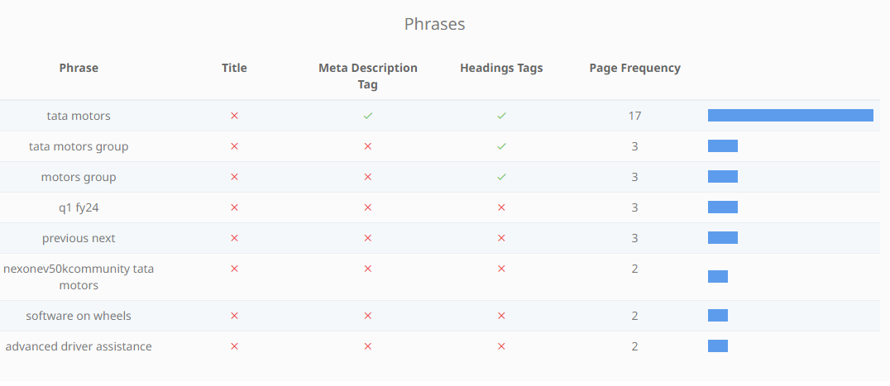

Slide 15
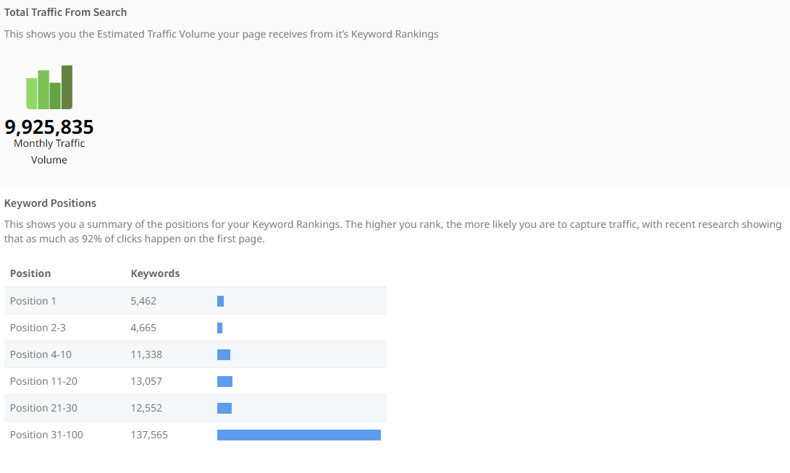

Slide 16

KEYWORDS RESEARCH
●
TATA CARS PRICE LIST
SHARE PRICE OF TATA MOTORS
TATA NEW CARS
TATA ALL MODEL CARS
SHARE VALUE OF TATA MOTORS
TATA EV CARS
TATA UPCOMING CARS
TATA PRIVATE LIMITED
FOUNDER OF TATA MOTORS

Slide 17

Marketing Strategies
Segmentation, targeting, and positioning: Tata Motors segments the market based on factors such as income, lifestyle, and needs. The company then targets specific segments with its products and marketing campaigns. For example, the Nano is targeted at low-income consumers, while the Jaguar Land Rover brands are targeted at high-income consumers.
Product differentiation: Tata Motors differentiates its products from those of its competitors by offering a variety of features and benefits. For example, the company's electric vehicles offer a range of features that are not available on other electric vehicles, such as a long driving range and a fast charging time.
Branding: Tata Motors has a strong brand image that is based on values such as trust, reliability, and innovation. The company uses its brand image to attract customers and build loyalty.
Digital marketing: Tata Motors uses digital marketing channels to reach its target audience. The company uses social media, search engine marketing, and email marketing to promote its products and services.
Tata Motors' marketing strategy is constantly evolving to meet the changing needs of its customers. The company is committed to providing innovative products and services that meet the needs of its customers and help it to achieve its business goals.

Slide 18

Content Ideas
History and overview of Tata Motors: This could include a timeline of the company's major milestones, its current product portfolio, and its global reach.
Innovation and technology at Tata Motors: This could focus on the company's research and development efforts, its use of new technologies in its vehicles, and its commitment to sustainability.
Customer stories and testimonials: This could highlight the experiences of real-world Tata Motors customers, and how the company's vehicles have improved their lives.
Expert interviews and insights: This could feature interviews with industry experts, such as automotive journalists, analysts, and academics, who can provide insights into the company's business and its future prospects.
Case studies and product reviews: This could provide in-depth analysis of specific Tata Motors vehicles, or case studies of how the company's products have been used in different applications.
Video content: This could include product videos, promotional videos, and behind-the-scenes videos that give viewers a glimpse into the company's operations.

Slide 19

Part 4: Content Creation and Curation (Post creations, Designs/Video Editing, Ad Campaigns over Social Media and Email Ideation and Creation)
Post Creation:
Select Content Categories: Identify three different content formats relevant to the chosen topic or industry. Research and Brainstorm: Research trending topics, industry news, or audience interests within each category. Brainstorm ideas for social media posts that align with each category. Do note that 1 content format has to be video and additionally 3 stories/status are to be created.
Format 1
Format 2
Format 3

Slide 20

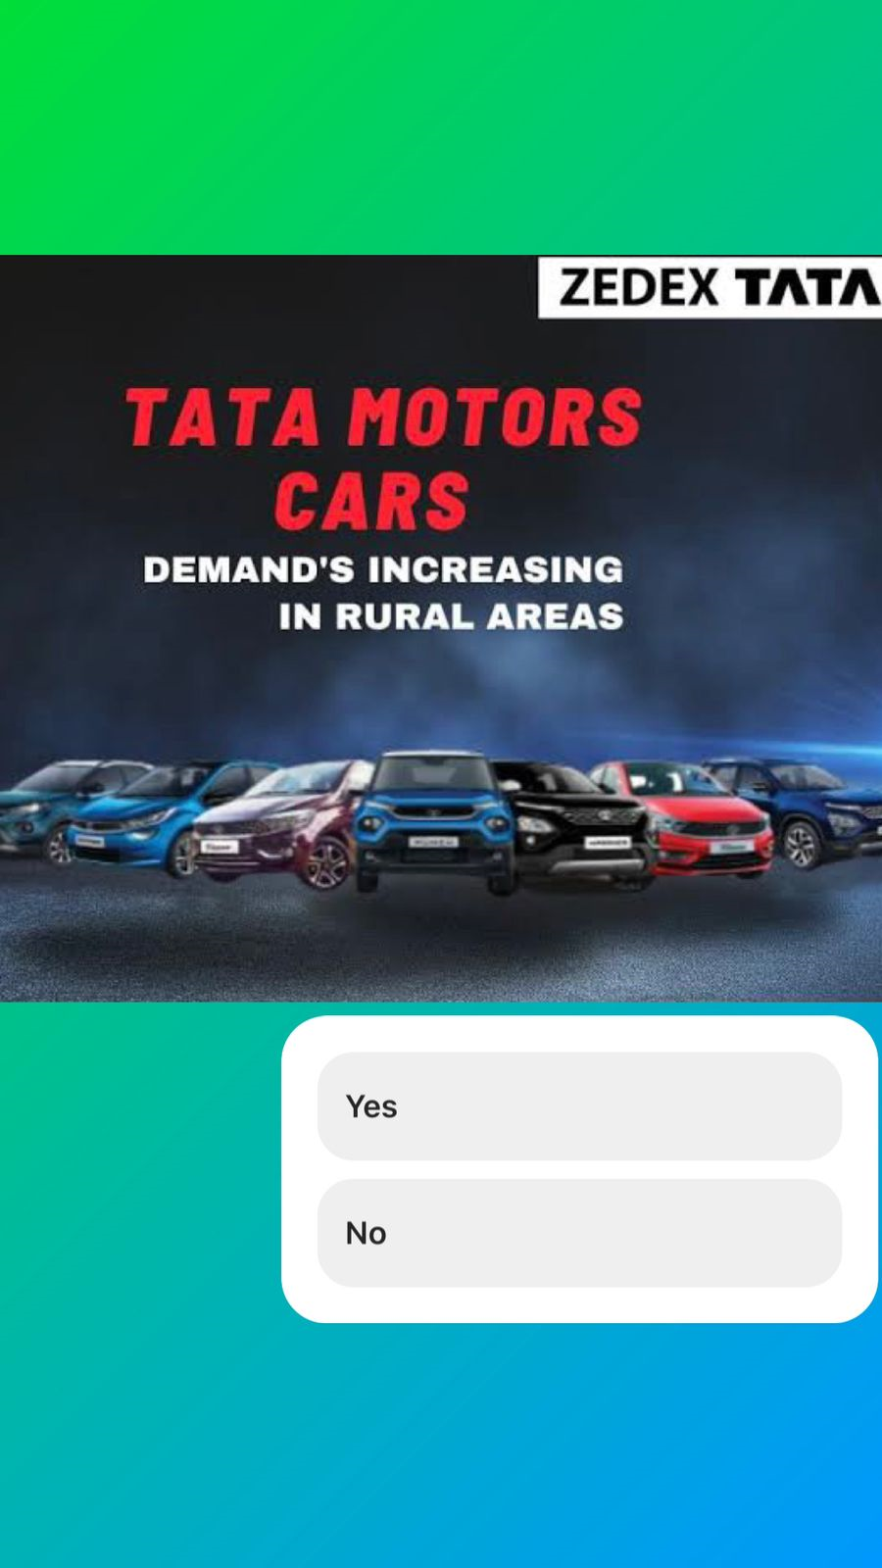
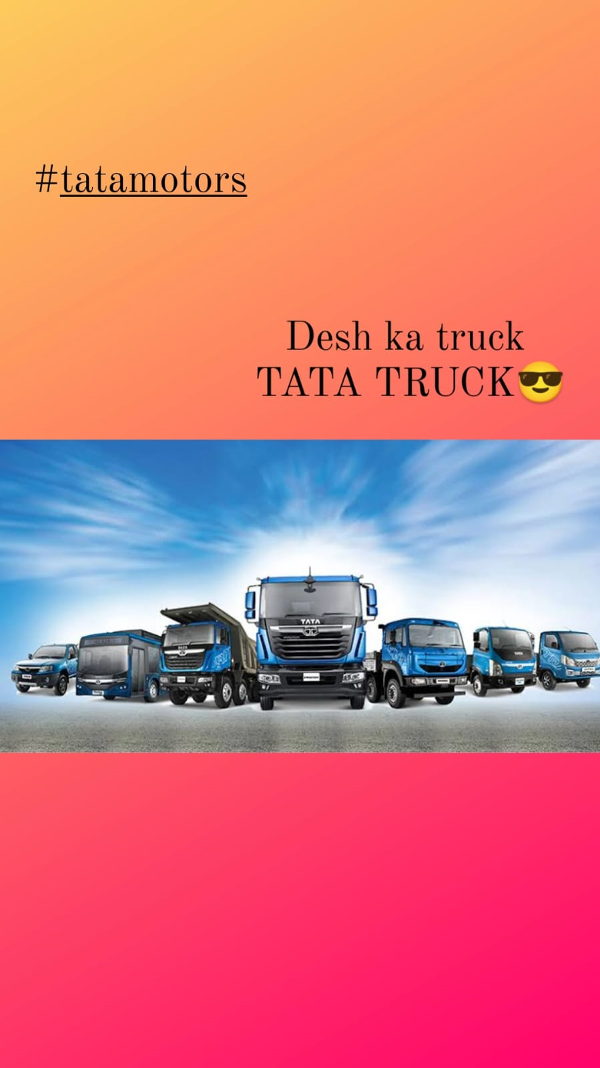
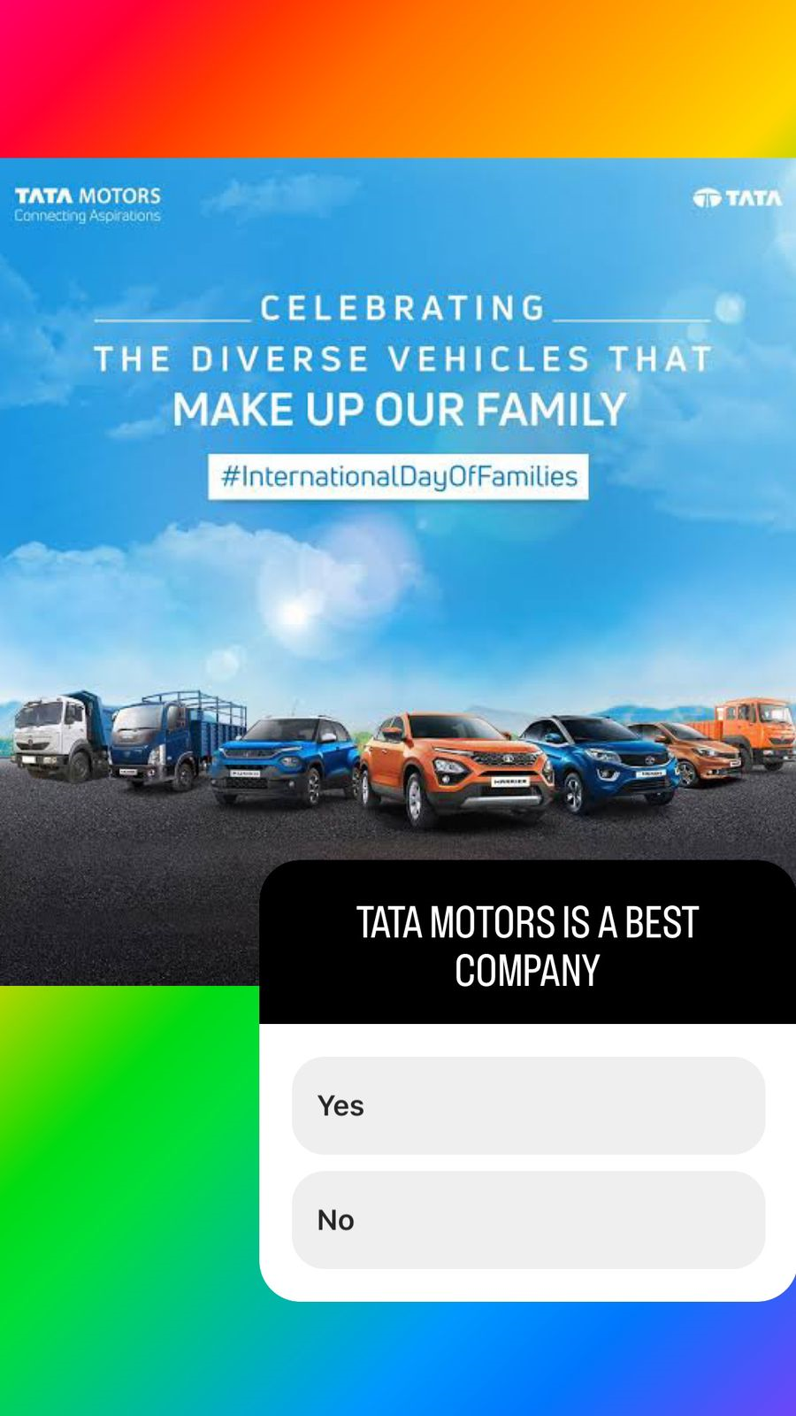
Instagram Story

Slide 21

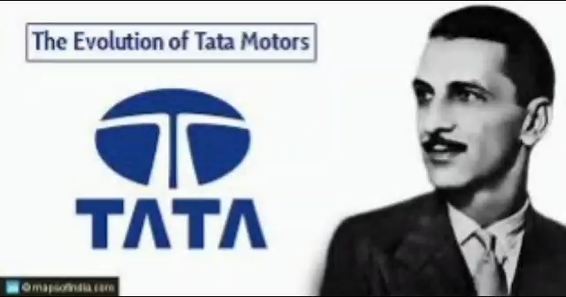
Part 4: Content Creation and Curation (Post creations, Designs/Video Editing, Ad Campaigns over Social Media and Email Ideation and Creation)
Designs/Video Editing

Slide 22

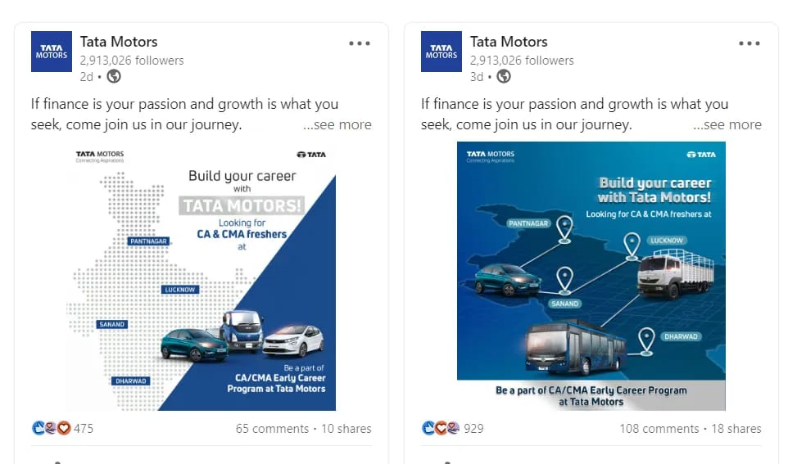
Social Media Ad Campaigns
Linked In :
Tata Motors uses LinkedIn to share a variety of content, including news about new products, company updates, and employee stories. The company also uses LinkedIn to engage with potential customers and
parteners.
By using LinkedIn targeting, Tata Motors can reach its target audience more effectively and efficiently. This can help the company achieve its marketing goals and grow its business.

Slide 23

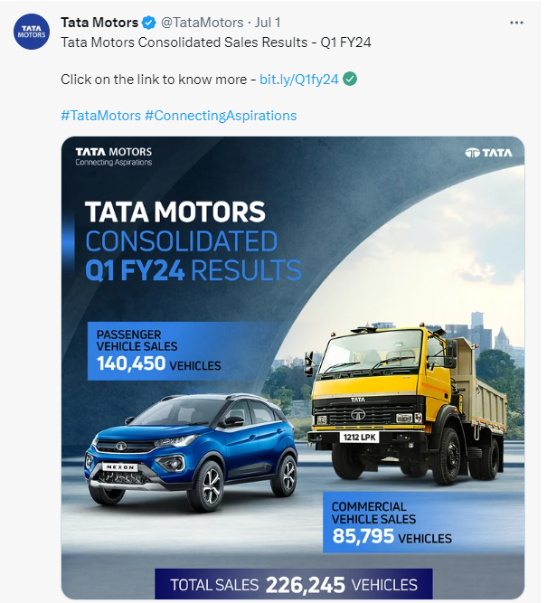
Social Media Ad Campaigns
Twitter :
Tata Motors has a strong brand awareness on Twitter. The company uses the platform effectively to share news, promote its brand, and engage with customers. This has helped Tata Motors to build a strong following of engaged users, which has in turn helped to drive sales.
From creating new priorities for the Indian car buyer to remaking legends,
From creating new ways to design cars to making new ways to save the planet,
We make the whole world of India's mobility

Slide 24

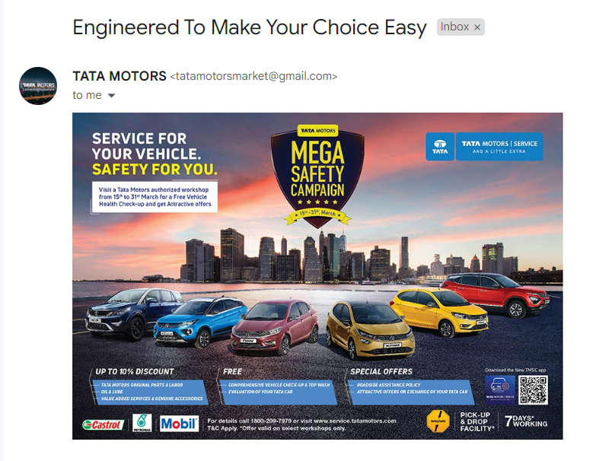
Email Ad Campaign 1 - Brand Awareness
Brand awareness model for experience products that overcomes the limitations of
consumer choice models, especially when it is not easy to consider some qualitative attributes
of a product or when there are too many attributes relative to the available amount of
preference date, by capturing the effects of unobserved product attributes with the residuals
of reference consumers for the same product. They decompose the deterministic component
of product utility into two parts: that accounted for by observed attributes and that due to non
observed attributes. By estimating the unobserved component by relating it to the
corresponding residuals of virtual experts representing homogeneous groups of people who
experienced the product earlier and evaluated it.

Slide 25

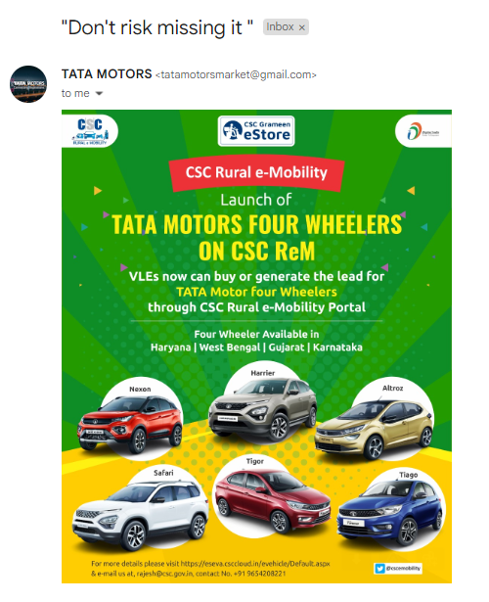
Email Ad Campaign 2 - Lead Generation
Tata Motors Ltd, one of the prides of the Indian automotive industry, has completed 75 years of leadership and resilience. After seven and a half decades, the company is today in a stronger position than ever, with both its divisions – the historic commercial vehicle one and the more recent passenger vehicle division – going strong and steady despite solid competition and an immensely changing and challenging market climate across both segments.
Tata Motors Group is one of the leading global automobile manufacturers with a diversified portfolio of commercial, passenger, and luxury vehicles. Part of the multi-national conglomerate, the Tata Group, the company has operations in India, the UK, South Korea, South Africa, China, Brazil, Austria and Slovakia through a strong global network of subsidiaries, associate companies and Joint Ventures (JVs), including Jaguar Land Rover in the UK and Tata Daewoo in South Korea.

